Slide 1
Amazon Web Services

Slide 2
What is AWS?
Amazon Web Services(AWS) offers cloud-computing services at affordable rates.
AWS follows a pay per use model, meaning you only pay for what you use.
You can get started with AWS for free, AWS runs a free usage tier in which you can use the AWS services in a very basic manner for free.

Slide 3
What is Cloud Computing?
Cloud computing is the on-demand delivery of compute power, database storage, applications and other IT resources through a cloud services platform via the Internet with pay-as-you-go pricing.
Cloud computing provides a simple way to access servers, storage, databases and a broad set of application services over the Internet.

Slide 4
What is Cloud Computing?
Cloud Computing is the use of remote servers on the internet to store, manage and process data rather than a local server or personal computer.
There are basically 3 categories in cloud computing
SaaS (Software as a Service)
PaaS (Platform as a Service)
IaaS (Infrastructure as a Service)

Slide 5
6 Advantages of Cloud Computing
Trade capital expense for variable expense.
Benefit from massive economies of scale.
Stop guessing about capacity.
Increase speed and agility.
Eliminate overhead cost of maintaining data centers
Go global in minutes.

Slide 6
3 Models of Cloud Computing
Infrastructure as a Service (IaaS)
Infrastructure as a Service (IaaS) is a self-service model for managing remote data center infrastructures. AWS offers IaaS in the form of data centers.
Platform as a Service (PaaS)
Platform as a Service (PaaS) allows organizations to build, run and manage applications without the IT infrastructure. This makes it easier and faster to develop, test and deploy applications.
Software as a Service (SaaS)
Software as a service (SaaS) replaces the traditional on-device software with software that is licensed on a subscription basis. It is centrally hosted in the cloud. A good example is Salesforce.com.

Slide 7
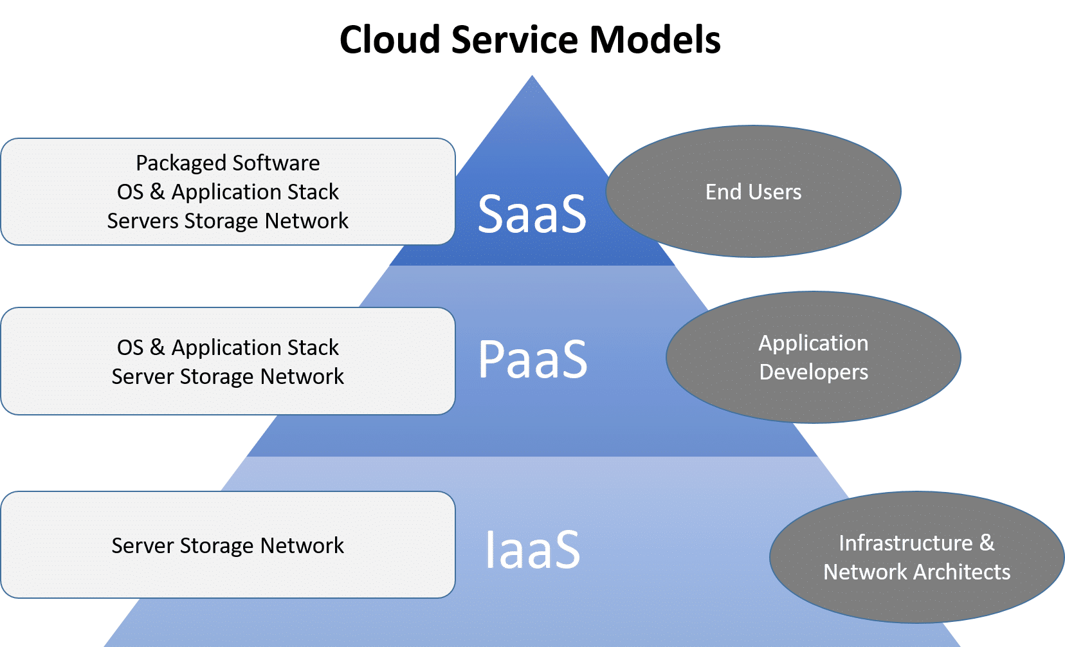
3 Models of Cloud Computing

Slide 8
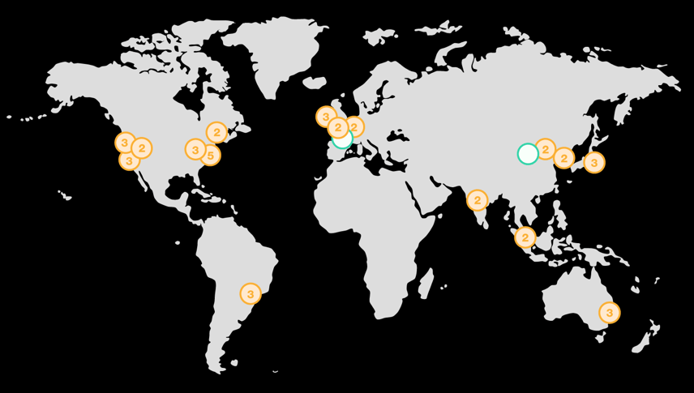
AWS Regions & Availability Zones
AWS now spans 77 Availability Zones within 24 geographic regions around the world, and has announced plans for nine more Availability Zones and three more AWS Regions in Indonesia, Japan, and Spain.

Slide 9
Regions, Availability Zones, and Local Zones
Amazon cloud computing resources are hosted in multiple locations world-wide.
These locations are composed of AWS Regions, Availability Zones, and Local Zones.
Each AWS Region is a separate geographic area.
Each AWS Region has multiple, isolated locations known as Availability Zones.
https://aws.amazon.com/about-aws/global-infrastructure/?p=ngi&loc=0

Slide 10
Regions, Availability Zones, and Local Zones
By using Local Zones, you can place resources, such as compute and storage, in multiple locations closer to your users.
Amazon RDS enables you to place resources, such as DB instances, and data in multiple locations.
Resources aren't replicated across AWS Regions unless you do so specifically.
Amazon operates state-of-the-art, highly-available data centers.
Although rare, failures can occur that affect the availability of DB instances that are in the same location.
If you host all your DB instances in one location that is affected by such a failure, none of your DB instances will be available.
Availability Zones consist of one or more discrete data centers, each with redundant power, networking, and connectivity, housed in separate facilities.

Slide 11
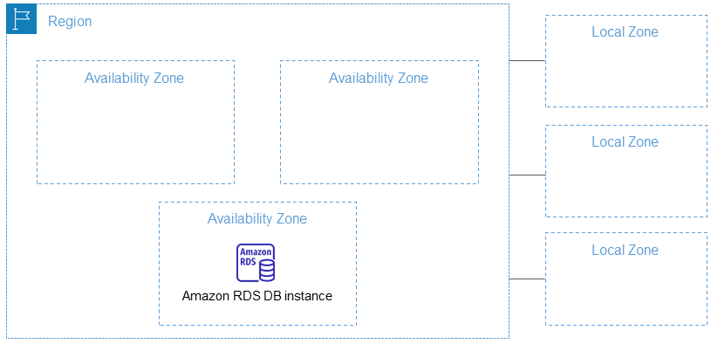
Regions, Availability Zones, and Local Zones

Slide 12
AWS Regions
Each AWS Region is designed to be isolated from the other AWS Regions.
This design achieves the greatest possible fault tolerance and stability.
When you view your resources, you see only the resources that are tied to the AWS Region that you specified.
This is because AWS Regions are isolated from each other, and we don't automatically replicate resources across AWS Regions.
Region Name | Region
US East (Ohio) | us-east-2
US East (N. Virginia) | us-east-1
US West (N. California) | us-west-1
Asia Pacific (Hyderabad) | ap-south-2
Asia Pacific (Mumbai) | ap-south-1

Slide 13
Availability Zones
An Availability Zone is represented by an AWS Region code followed by a letter identifier (for example, us-east-1a).

Slide 14
AWS Services
Explore the different domains in which AWS offer services

Slide 15
Compute
AWS EC2 : It is a web service which provides re-sizable compute capacity in the cloud. It is designed to make the web-scale computing easier for developers.
AWS Elastic Beanstalk : Elastic Beanstalk lets you quickly deploy and manage applications in AWS without worrying about the underlying infrastructure.
AWS Elastic Load Balancing : ELB automatically manages the workload on your instances and distributes them to other instances in case of an instance failure.
AWS Lambda : AWS Lambda is used to execute backend code without worrying about the underlying architecture, you just upload the code and it runs, it’s that simple!
AWS Autoscaling : The Autoscaling feature is used to scale up and down automatically as and when required.

Slide 16
Storage and Content Delivery
S3 AWS : S3 stands for simple storage service, it is used for storing data in the form of objects in the AWS Cloud.
Amazon CloudFront : CloudFront is a content delivery network which is used to cache data to an edge location which reduces latency.
Amazon EBS : Amazon Elastic Block Storage is a storage service wherein each block of storage acts like a separate hard drive.
Amazon Glacier :Glacier is an archiving service offered by Amazon, which offers low-cost data archiving.
AWS Import/Export Snowball : It offers physical transfer of data between user’s location and AWS data centers, the device which is used to transfer the data is called Snowball.

Slide 17
Database
Amazon Aurora : It is a relational database engine that combines the speed and reliability of high-end commercial databases and the cost-effectiveness and simplicity of open-source databases.
Amazon RDS : Amazon RDS is a managed relational database service which does routine database tasks in 6 familiar databases like Amazon Aurora, MySQL, MariaDB, Oracle, Microsoft SQL Server, and PostgreSQL.
Amazon DynamoDB : It is a fully managed No-SQL database service. It is known for extremely low latencies and scalability.
Amazon ElastiCache : It is a web service that makes it easy to set up, manage and scale a distributed cache-in environment in the cloud.
Amazon Redshift : Amazon Redshift is a fully managed petabyte-scale data warehouse service in the cloud.

Slide 18
Networking
VPC AWS : Amazon VPC lets you launch AWS resources in a virtual network that you define. It closely resembles a traditional network that you’d operate in your data center.
AWS Direct Connect : It helps you establish a private connection between your premises and AWS, therefore giving better network performance and throughput than an Internet-based connection.
Amazon Route 53 : Route 53 is a highly scalable and highly available Domain Name System by Amazon AWS. The name is in reference to the TCP and UDP’s port 53 where DNS requests are addressed.

Slide 19
Management Tools
Amazon CloudWatch : It is a monitoring tool by AWS which is used to keep a track on the AWS resources and the applications you run on Amazon AWS.
AWS CloudFormation : It is a service which helps you set up and model your Amazon AWS resources so that you can spend less time managing these resources and more time focusing on the development.
AWS CloudTrail : AWS CloudTrail is a logging service which records the API calls to your Amazon AWS account and delivers them to you.
AWS Command Line Tool : It is an all in one tool to manage all your AWS services, by downloading and configuring only one tool you can manage all the AWS services through the command line.
Trusted Advisor : Trusted Advisor is a customized cloud monitoring tool, that analyzes your AWS environment and gives insights on the expense, performance improvement, security gaps, and reliability.

Slide 20
Security and Identity
AWS Identity and Access Management(IAM) : It is an AWS service that helps you control access to your AWS resources for your users.
AWS Key Management Service : It is a managed service that helps you create and control encryption keys which are used to encrypt your data, and uses Hardware Security Modules to protect the security of your keys.

Slide 21
Messaging Services
Amazon SES : It is a cost-effective emailing service which is built on the scalable and reliable infrastructure of Amazon.com
Amazon SNS : It is a web service offered by AWS that manages the delivery of messages to subscribed endpoints or clients.
Amazon SQS : It is a fast, reliable and scalable message queuing service, it can be used to transmit any volume of data at any level of throughput, without losing any messages or without the use of any other service.

